Slide 1

INSIGHT MATH
MATHEMATICAL APP FOR VISUALLY IMPAIRED
Aryan Gwalani (2020400010)
Sahil Nawale (2020400029)
Atharv Raotole (2020400042)
Tanish Shah (2020400050)

Slide 2
1
INDEX
Know Your Client
Screen-Based controls
Understand Business Functions
Effective feedback and guidance
Icons
Understand Principles of Good screen design
Colors
System Menu Navigation
Test
Windows

Slide 3
2
ABSTRACT
This presentation explores the development and implementation of mathematical applications designed specifically for visually impaired users. The focus is on enhancing accessibility to mathematical education and practice through innovative technologies that adapt to the unique needs of these learners. We will examine key features such as audio feedback, tactile interfaces, and integration with existing assistive technologies like screen readers. The applications discussed aim to provide an inclusive, intuitive learning environment that empowers visually impaired students to explore mathematical concepts independently. This session highlights the challenges, solutions, and impact of these specialized tools, underscoring the importance of accessible design in educational technology.

Slide 4


KNOW YOUR CLIENT
3
Understanding Visual Impairment:
Recognize types and degrees of visual impairment.
Acknowledge challenges in accessing mathematical content.
Accessibility Needs:
Identify specific requirements such as screen readers, and braille displays.
Understand preferences for input methods.
User Goals and Objectives:
Determine the purpose (e.g., educational, professional).
Understand users' objectives in accessing mathematical content.
Challenges and Pain Points:
Gather feedback on current obstacles in accessing mathematical content.
Identify key pain points in existing solutions.
Feedback and Iteration:
Establish channels for ongoing user feedback.
Prioritize user input to improve app accessibility and usability.

Slide 5

UNDERSTAND BUSINESS FUNCTION
4
Features:
Personalized learning experiences.
Voice-controlled navigation.
Braille display compatibility.
High-contrast visuals for partial vision.
Accessible mathematical expressions.
Impact:
Enhances academic growth and inclusivity.
Sets a standard for accessible educational technology.
Future Goals:
Evolve through community feedback.
Broaden subject coverage and educational tools.

Slide 6
5
UNDERSTAND PRINCIPLE OF GOOD SCREEN DESIGN
Clarity and Simplicity | Ensure interface elements are clear and easy to understand. Simplify complex information to enhance accessibility.
Consistency | Maintain consistency in design elements throughout the app. Use consistent layouts, colors, and navigation patterns.
Hierarchy and Organization | Establish clear visual hierarchy to prioritize important content. Organize information logically to facilitate easy navigation.
Accessibility Considerations | Design with accessibility in mind, ensuring compatibility with screen readers and assistive technologies. Use sufficient color contrast and provide alternative text for images.
Interactive Elements | Design interactive elements with clear affordances for users. Provide feedback for user actions to enhance usability.
Scalability | Design the interface to accommodate varying screen sizes and resolutions, ensuring a consistent user experience across devices.

Slide 7
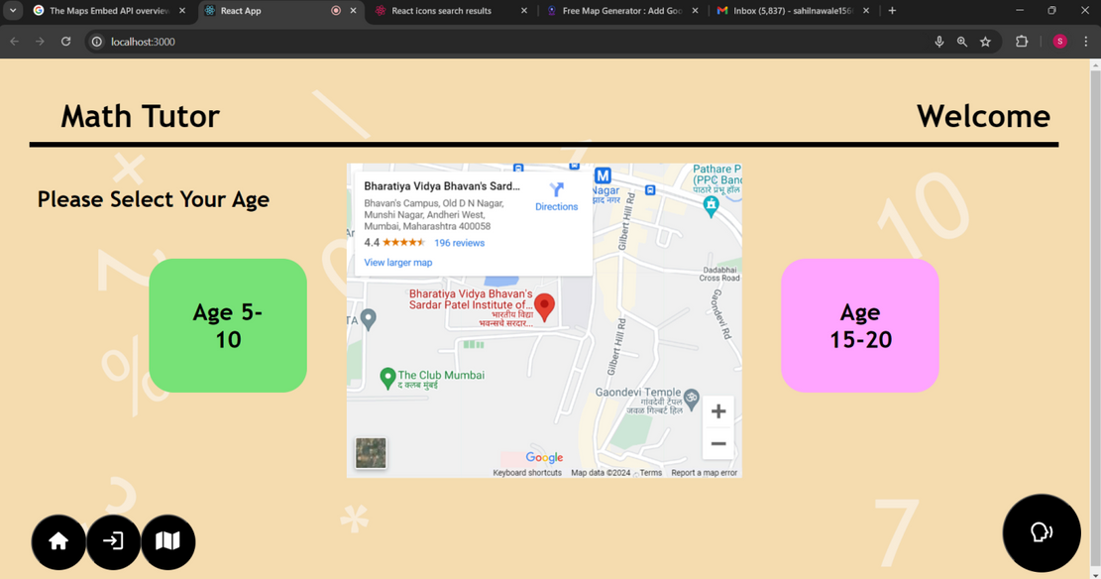
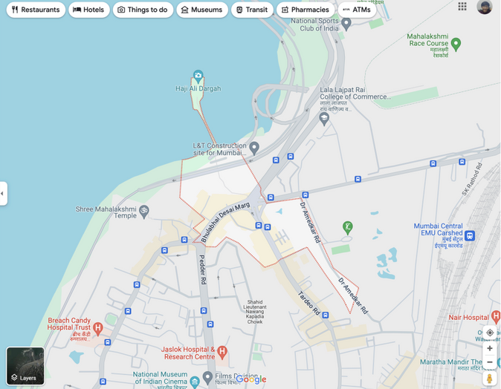
SYSTEM MENU NAVIGATION
6
Effortless Access to Learning
Simplified Menu: Streamlined for ease of use.
Voice-Guided Tours: Familiarize students with menu layout.
Tactile Feedback: Confirm selections.
Shortcut Keys: Quick access to functions.
Consistent Layout: Uniform design across pages.
Navigation Aids
Audio Cues: Different sounds for actions.
Help Mode: On-demand assistance.
User-Centric Design
Developed with input from visually impaired students.

Slide 8
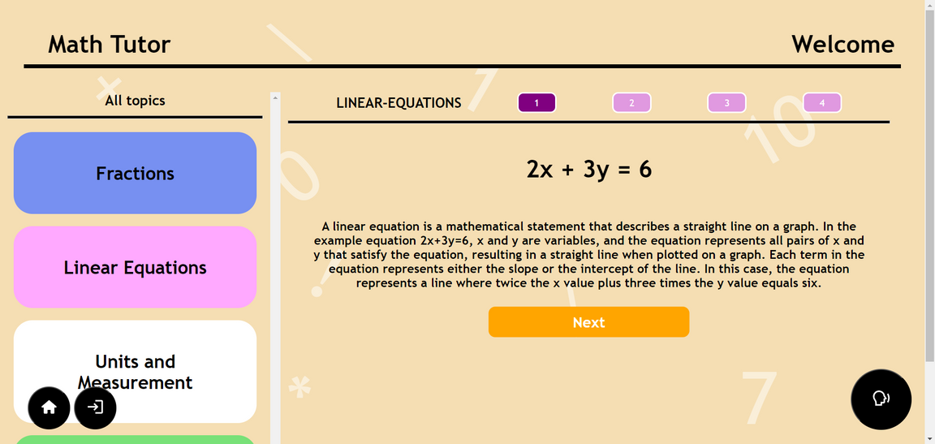
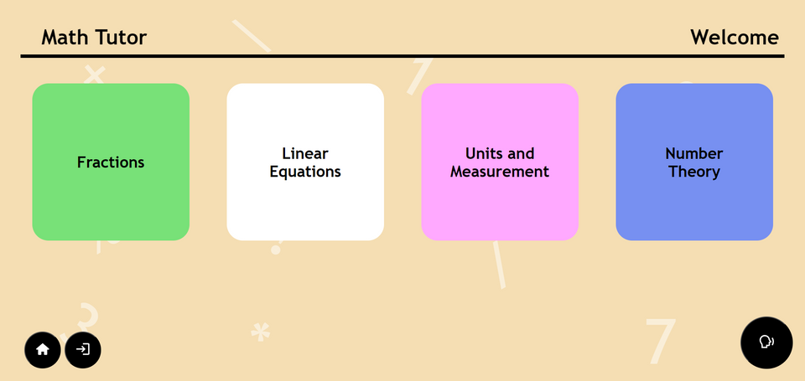
7
WINDOWS
Characteristics: Windows have properties like a name/title, dimensions (height and width), state (active, minimized, etc.), visibility (fully visible or partially hidden), management capabilities (resize, move, etc.), ability to highlight/select portions, and a specific function or application they are associated with.
Components: Windows typically have a surrounding frame/border, a top title bar displaying the window's name and icons, buttons in the title bar to minimize, maximize, or close the window, and system menu icons.
Presentation Styles: Windows can be displayed in different arrangements like tiled (side-by-side filling screen), overlapping (stacked allowing obstructed view), or cascading (overlapped in a staggered pattern).
Types: There are primary windows that are the main application window with menus and toolbars. Secondary windows are supplemental pop-ups or dialogs dependent on the primary window. Website code can also create embedded frames or pop-up browser windows.

Slide 9
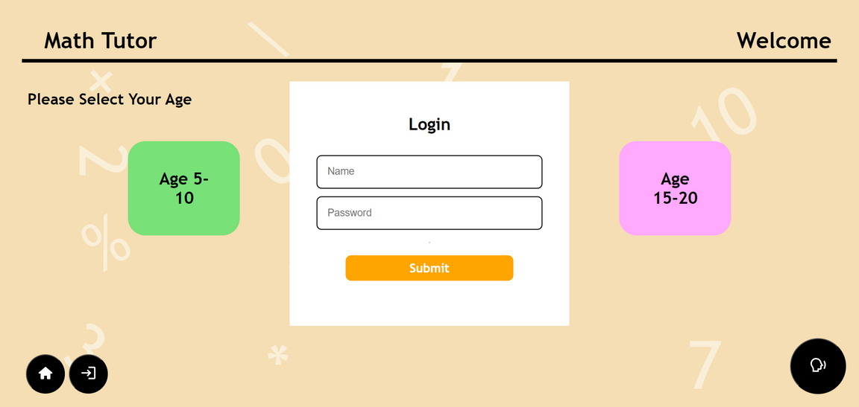
SCREEN CONTROLS
8
Operable Controls enable user input and interaction like text boxes, buttons, checkboxes, drop-downs, and spin boxes to enter, edit, or trigger actions.
Presentation Controls are informational, displaying data like static text labels, group boxes, column headers, tooltips showing control descriptions, and progress bars indicating processes.
Other Controls include sliders to make value selections, tabs to switch between views, and to navigate through content.
Accessibility is enhanced through keyboard navigation and shortcuts as an alternative to mouse/pointer, voice recognition for voice commands, and adjustable audio feedback like text-to-speech readout and audio cues to guide visually impaired users.

Slide 10
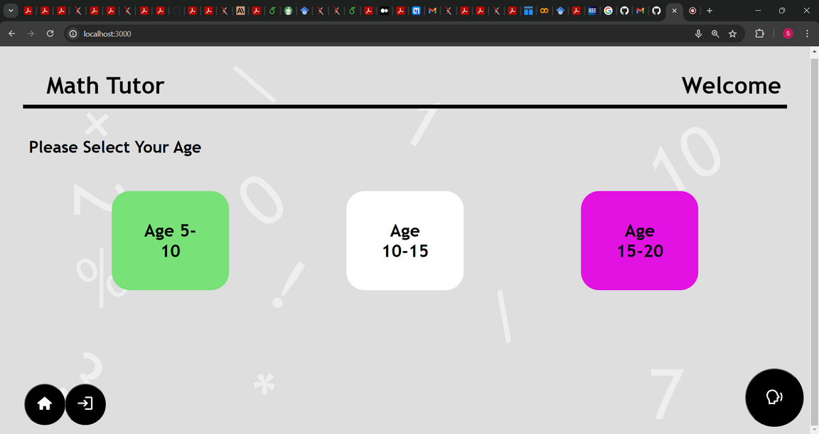
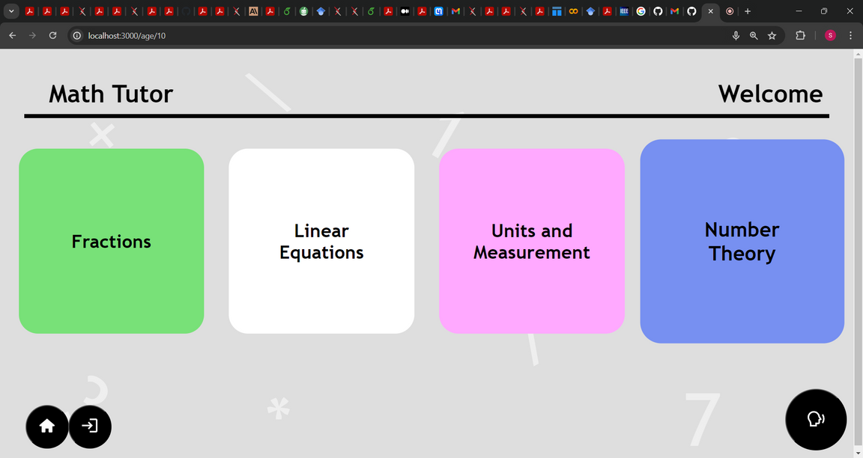
COLORS
9
Balanced Contrasts: High contrast, carefully balanced for clarity without strain.
Sectional Color Differentiation: Each section has a distinct color palette for easy navigation.
Maximized Readability: Optimal text contrast for readability, especially for impaired users.
Intuitive Navigation: Familiar color associations aid easy navigation.
Subtle Emphasis: Cool backgrounds subtly guide attention without overwhelming.
Vibrant Highlights: Saturated colors draw attention to important sections.
Balanced Framing: Limited contrasting elements for visual comfort.

Slide 11
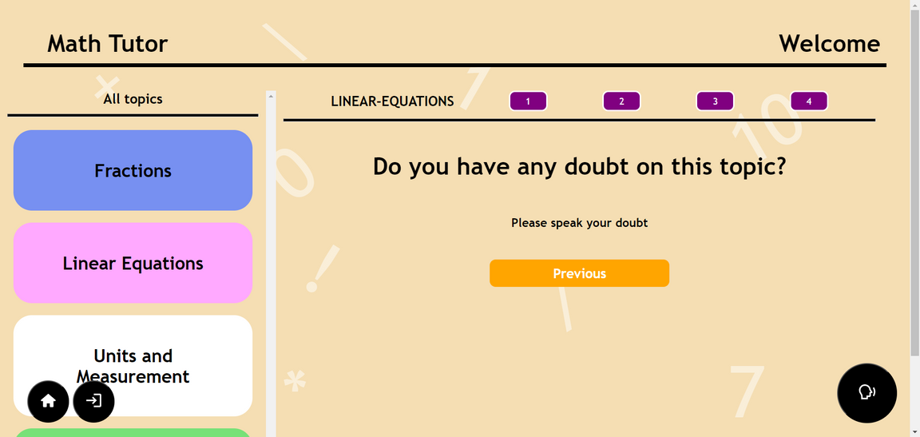
EFFECTIVE FEEDBACK AND GUIDANCE
10
Usability & Functionality
Feedback: Icons should be efficient and match user expectations.
Achievement: Designed icons to be familiar, direct, and efficient, considering task complexity.
Context & Integration
Feedback: Icons should fit the website's context and voice input
Achievement: Incorporated icons into a voice-guided navigation system tailored to math tutoring.
Consistency & Scalability
Feedback: Maintain icon consistency and allow for scalability.
Achievement: Established a standardized design approach and provided icons in standard sizes.

Slide 12



ICONS
11
Design Principles
Icons are familiar, clear, simple, consistent, direct, efficient
Designed considering Context, user expectations, task complexity
Icon Utilization
Icons visually represent actions and info
Used for categorizing math topics and enhancing interaction
Conclusion
Icon set tailored for the visually impaired.
Enhances engagement and navigation using voice input.
Facilitates easy interaction with math content

Slide 13
12
TEST & RETEST
1
3
Acceptance testing by user
User testing login functionality
2
Testing of accessibility and complexity of features

Slide 14
THANK YOU
Presented By: Group 4

